Slide 1
Opportunities to enhance safe chemical manufacturing with electrochemical processes
Brian M. Tackett
Assistant Professor of Chemical Engineering
Purdue University

Slide 2
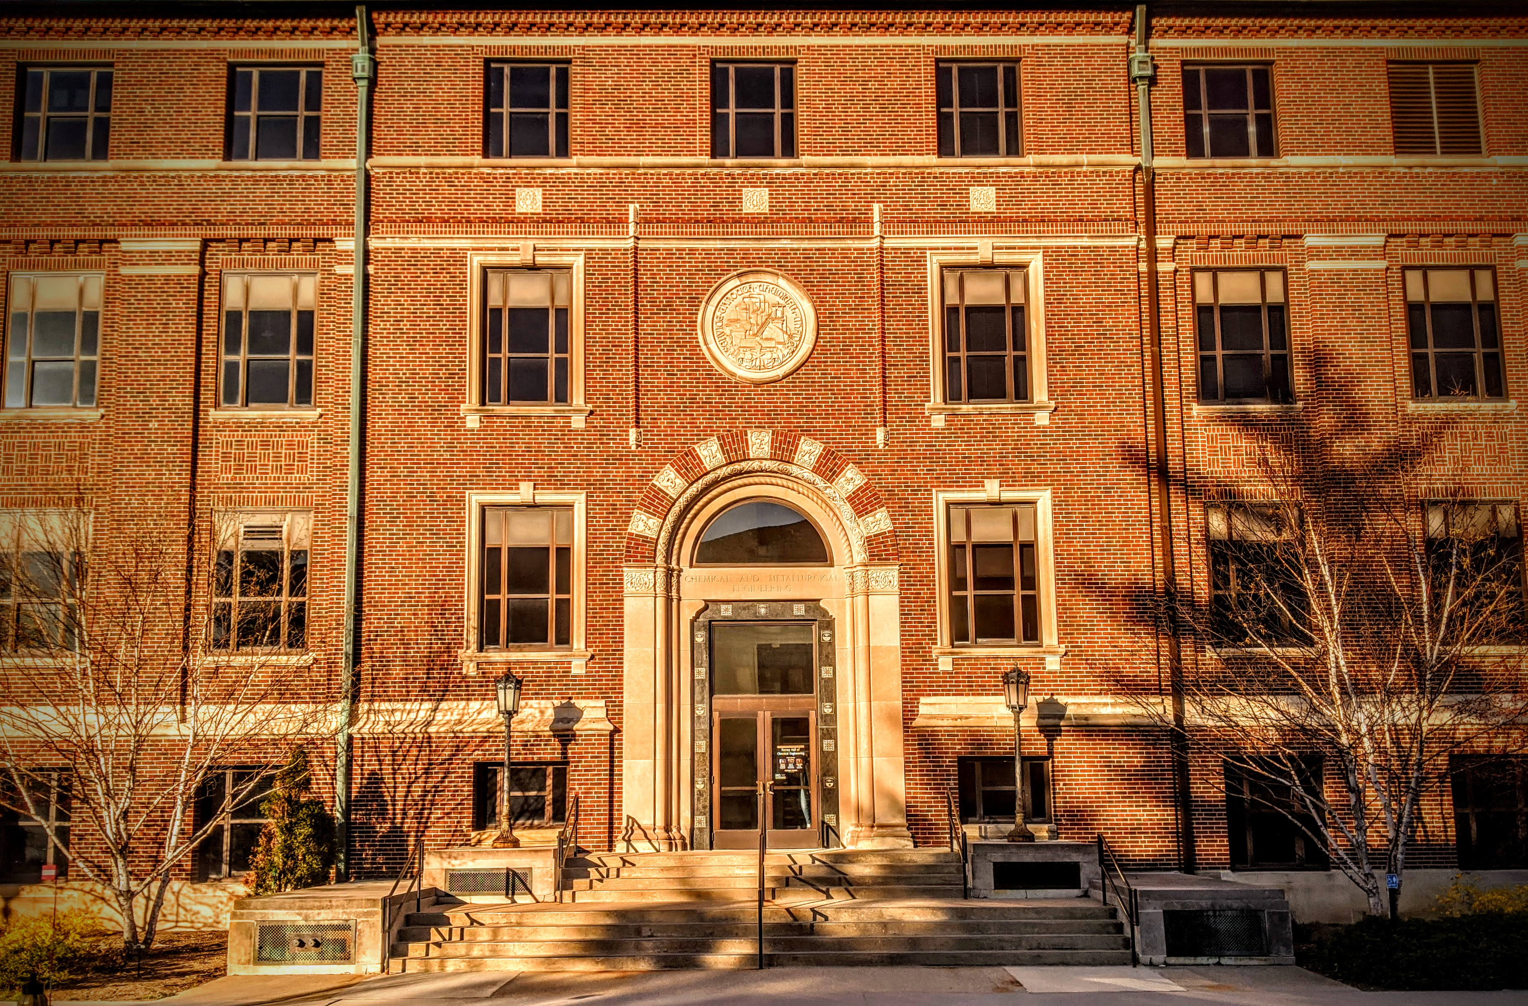
About Me
Education & Background
BS Chemical Engineering, University of Pittsburgh (2009 – 2013)
PhD Chemical Engineering, Columbia University (2014 – 2019) Advisor: Jingguang Chen (Electrocatalysis & Sustainability)
NRC Post-Doctoral Fellowship, NIST (2019 – Aug. 2021) Advisor: Tom Moffat (Electrochemistry Fundamentals)
Asst. Prof. Chemical Engineering, Purdue University (Aug. 2021 – )

Slide 3
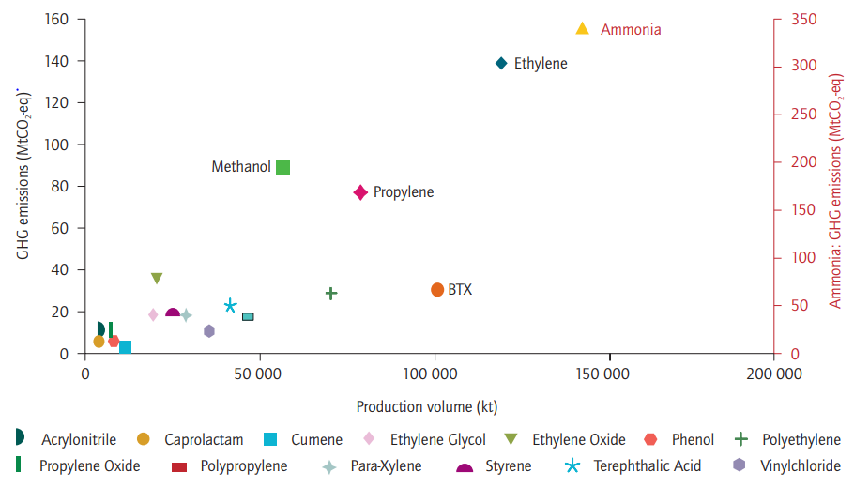
Hazards of Industrial Oxidation Processes
O
Case Study: Ethylene Oxide Synthesis
Route 1: Direct Oxidation
C₂H₄ + O₂ → C₂H₄O + CO₂
~10% single pass conversion @ 200 – 260 C
Higher T, above flammability limit
Route 2: Chlorohydrin Process
C₂H₄ + Cl₂ + H₂O → + Ca(OH)₂ → C₂H₄O + CaCl₂ + H₂O
EO is a high-value, high-volume product with large CO₂ footprint

Slide 4
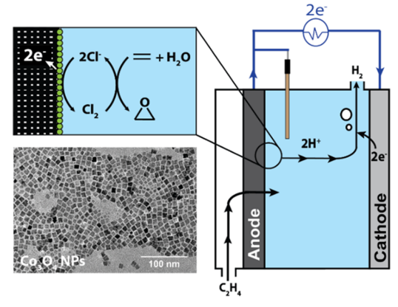
An Electrochemical Alternative
O
Case Study: Ethylene Oxide Synthesis
Chlorine mediator is generated electrochemically at an electrode by electron transfer from aqueous Cl⁻ salt
Cl₂ and H₂O transform ethylene to EO in the same manner as chlorohydrin process
Resulting Cl⁻ ions are recycled as mediators (no stoichiometric waste)
Occurs @ 90 C
Electrochemical reactors provide unique opportunity
Can we synthesize EO more efficiently without handling toxic chemicals or risking explosions?
Chung, M., Jin, K., Zeng, J. S., & Manthiram, K. (2020). ACS Catalysis, 10, 14015–14023.

Slide 5
An Electrochemical Alternative
General Advantages of Electron-Driven Reactions
Driving force for chemical reaction = electrochemical potential (i.e. voltage)
Facilitates ambient T processes
Enables finer selectivity control
Reaction rate $∝$ current
Quantifies rates accurately (10⁻¹² mol/s)
Electrodes are versatile
Conduct charge to redox mediators
Catalyze reaction directly (enhance activity/selectivity)
Electrochemical reactors provide unique opportunity
These enable selective oxidations that can potentially mitigate hazards in chemical processing
Chung, M., Jin, K., Zeng, J. S., & Manthiram, K. (2020). ACS Catalysis, 10, 14015–14023.

Slide 6
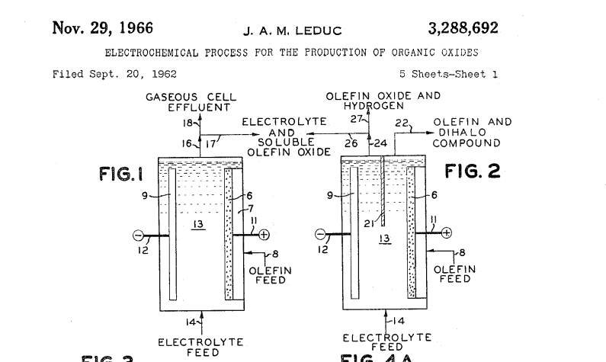
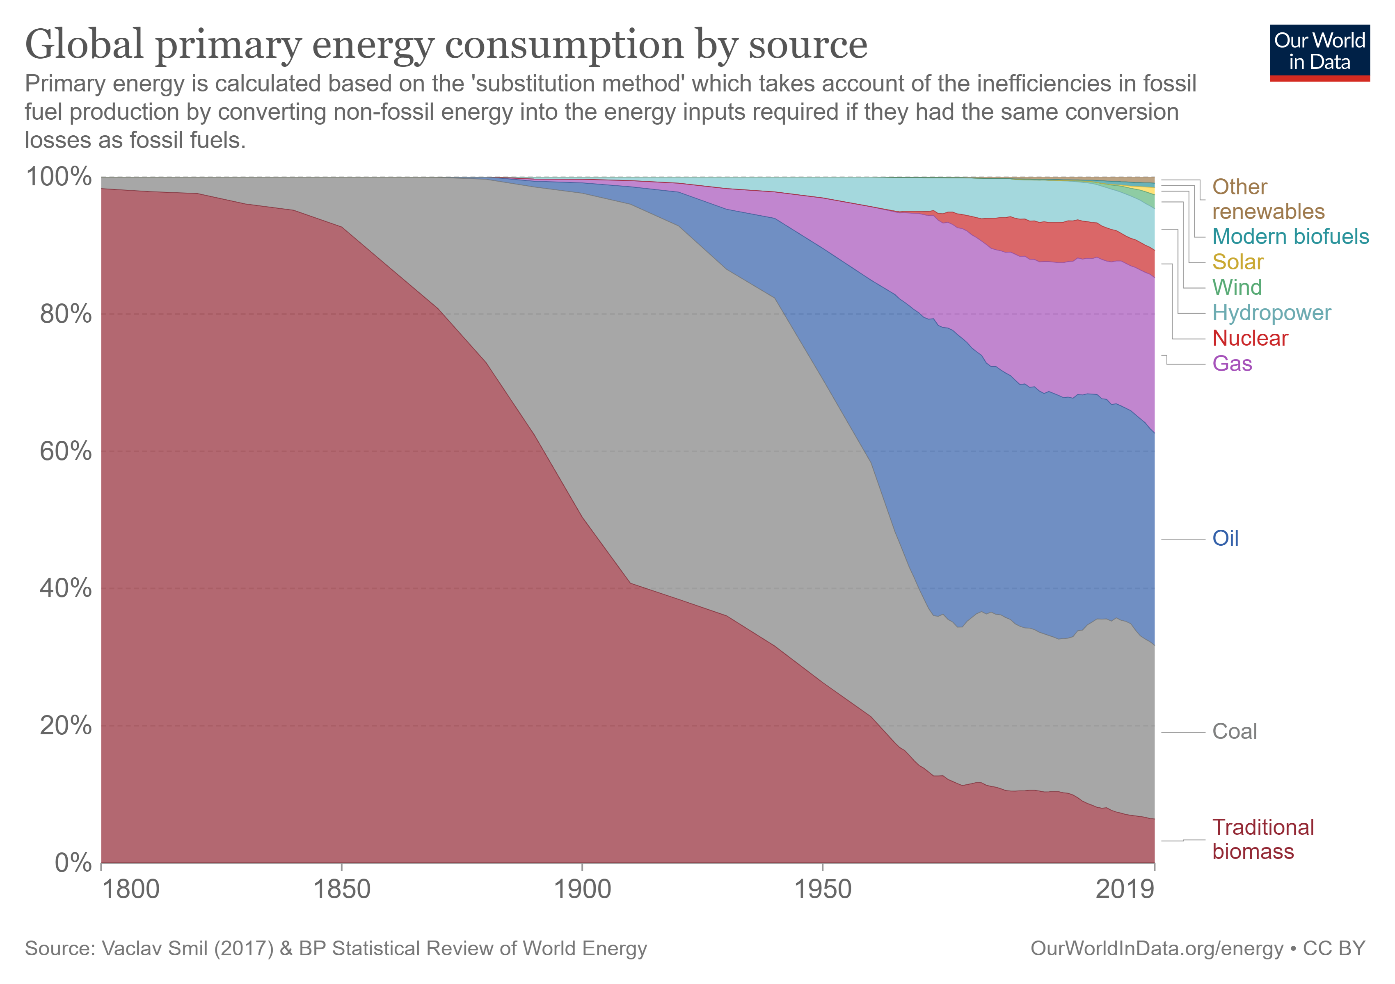
Why, What, and How?
Why Now?
Electrochemical process have been around a long time
Rapidly increasing abundance of electrons originating from wind/solar are motivating electrification, broadly
Many great ideas from the past are now more economically/energetically attractive

Slide 7
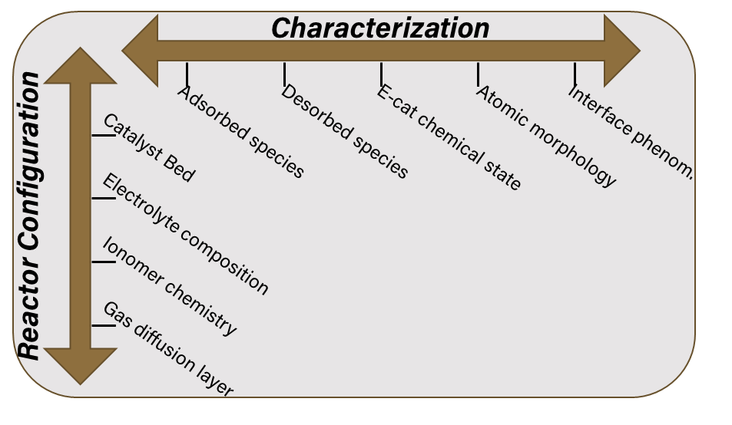
Why, What, and How?
What Do We Need to Realize This Vision?
Characterization:
Catalyst/reactor techniques developed over previous decades typically not suitable for gas-liquid-solid interfaces commonly found in electrocatalysis
Need: New/modified characterization techniques specifically designed for electrocatalysts (EC-MS, SEIRAS)
Reactor Configuration:
Electrocatalysts do not stand alone – they are influenced by: conductive current collector supports, gas diffusion layers, ion transport media (ionomer), electrolyte, membrane, etc.
Need: Holistic approach to reactor design/analysis
Education:
Chem/ChemEs are best suited to pursue these problems, but lack of training results in large depth/breadth of electrochem. manufacturing challenges to address
Need: Integrated curriculum that presents electrochemistry along with Chem/ChemE core
Spectroscopy
Spectroscopy
reactants
products
reactants
Liquid electrolyte
products
catalyst
electrocatalyst

Slide 8
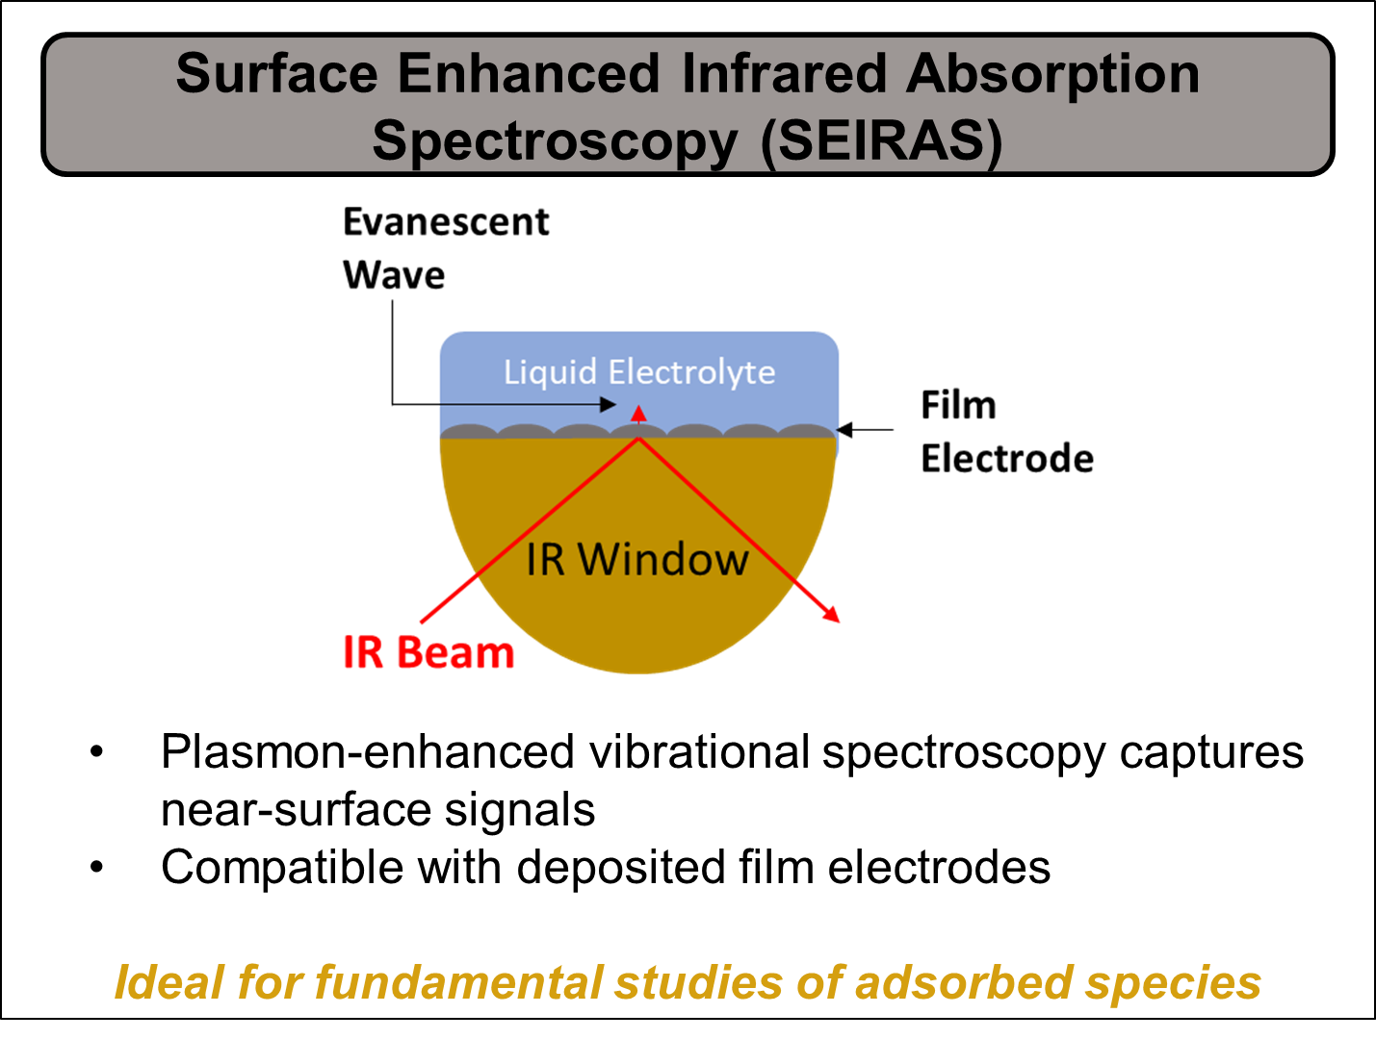
Why, What, and How?
How Am I Approaching These Challenges?
My lab has a unique combination of characterization techniques that enable study of a wide array of electron-driven chemical reactions

Slide 9
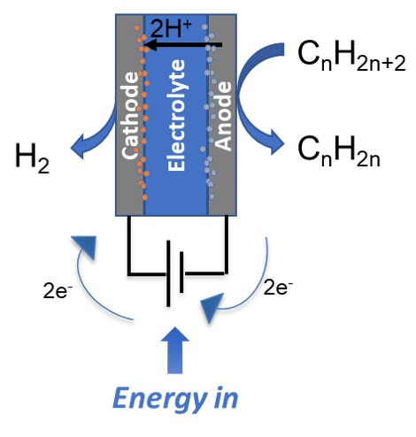
Why, What, and How?
How Am I Approaching These Challenges?
My lab has a unique combination of characterization techniques that enable study of a wide array of electron-driven chemical reactions
Our department has collaborative and complementary faculty that enable multi-scale electrochemical reactor studies
Electrochemcial alkane dehydrogenation enhances safety → thermodynamic advantages of oxidative dehydrogenation without mixing O₂ + alkane.

Slide 10
Summary and Opportunities
Electrochemical processes enable unique chemical manufacturing routes that could enhance process safety
Rapid influx of solar/wind motivate re-evaluation of electrochemical manufacturing
Realizing safe electrochemical process requires improvements in characterization/reactor configuration/education
My research approach is adaptable to broad range of electron driven chemistries that could improve safety of chemical manufacturing
Potential opportunities to enhance chemical manufacturing with electrochemical processes
Replace Cr-based reagents for C-H activation
Electrochemical H₂SO₄ synthesis
Electrochemical Claus Process to treat industrial gases (H₂S → S)
Indirect/mediated halogenations

